Slide 1
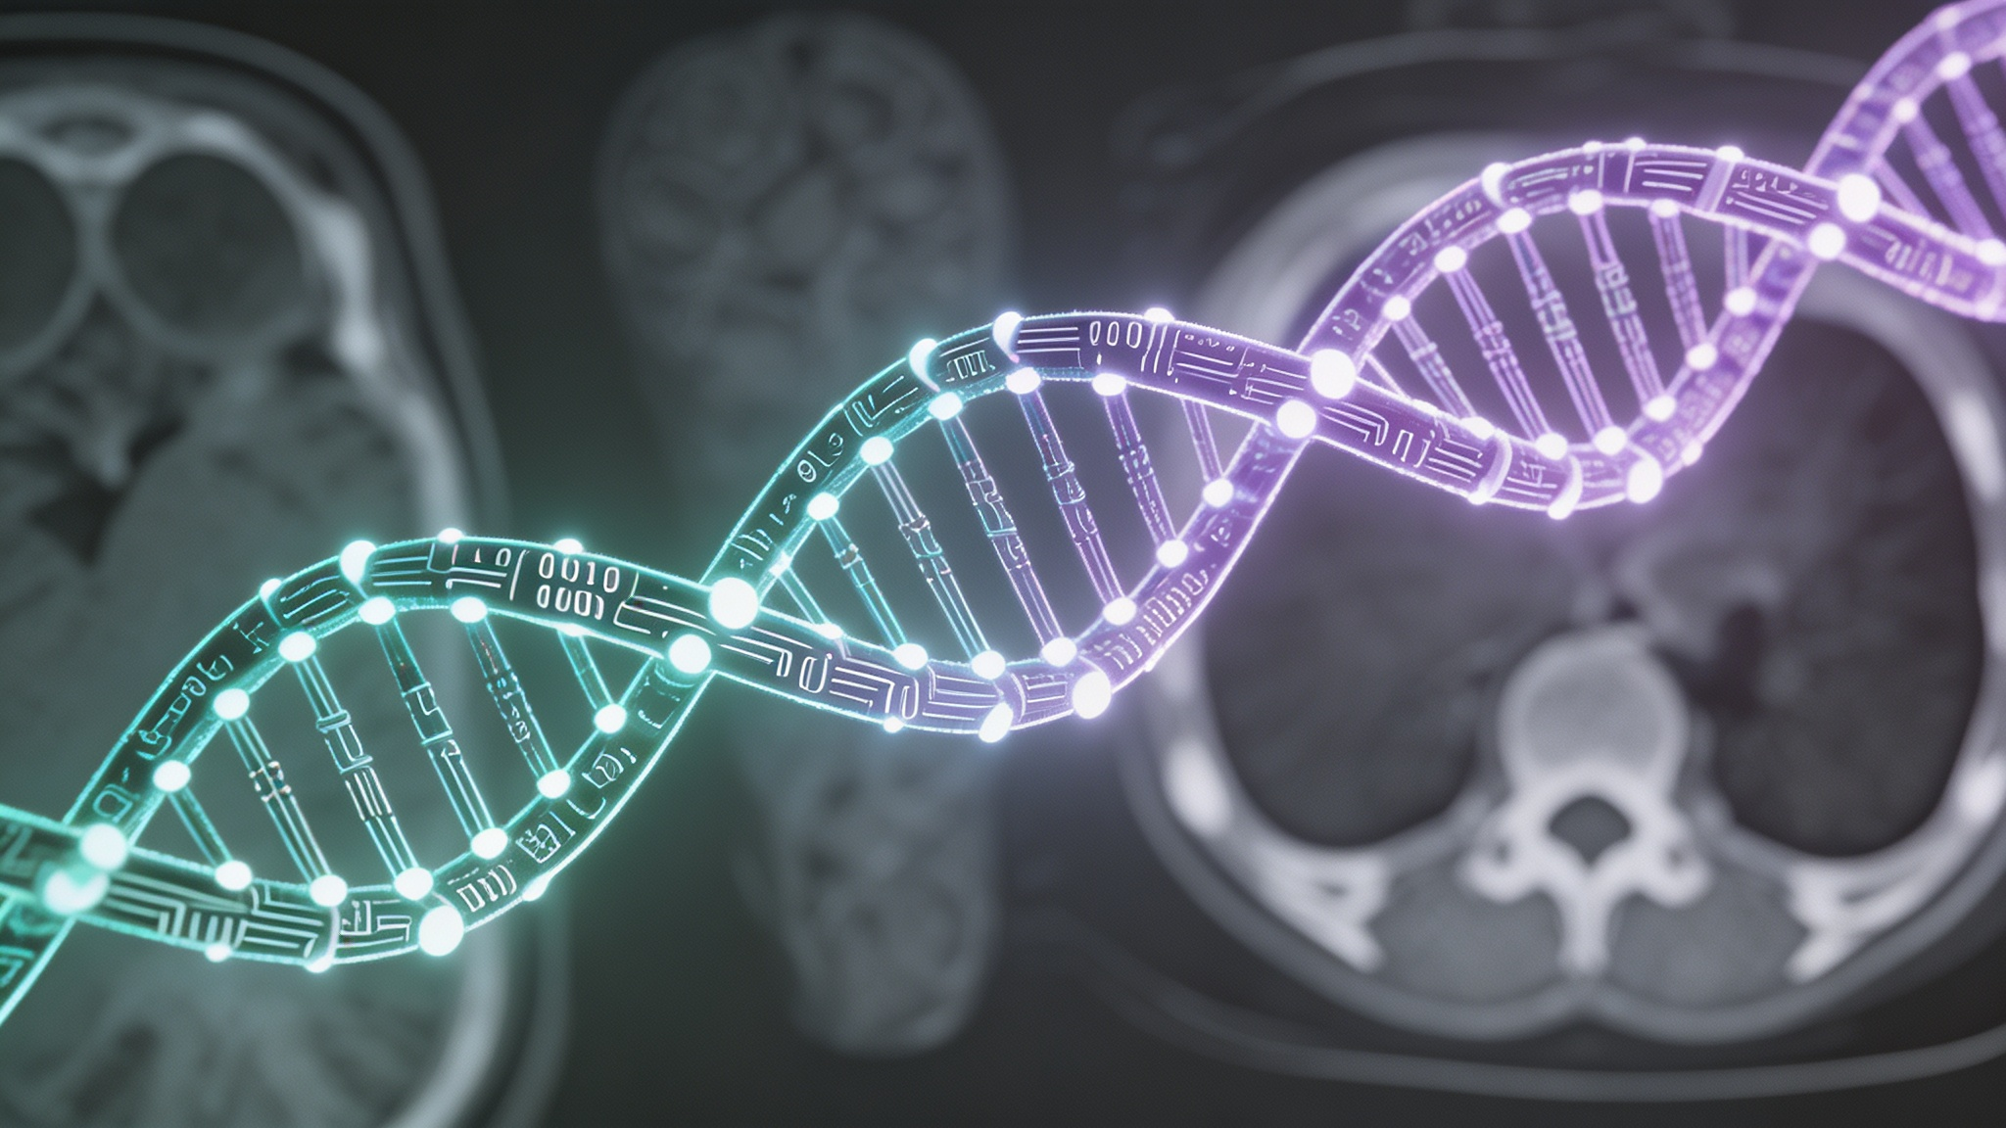
Deep Learning in Medical Image Analysis:
A Comprehensive Review
Model Readiness Assessment:
From Research to Clinic
PRESENTER: Yang Fenghsuo
DATE: APRIL 21, 2026
Notes:
hello everyone. My presentation is about the topic: A Comprehensive Review combined DL and MIA

Slide 2
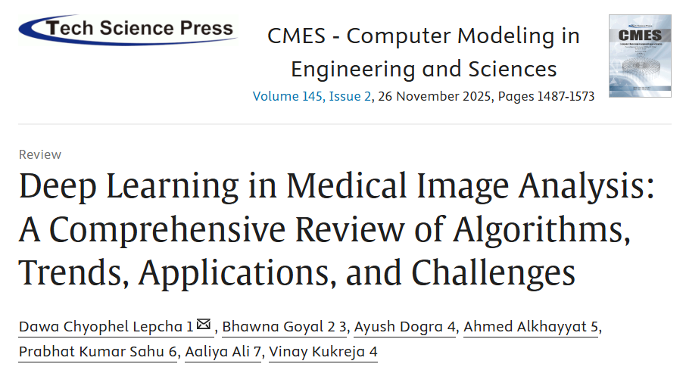
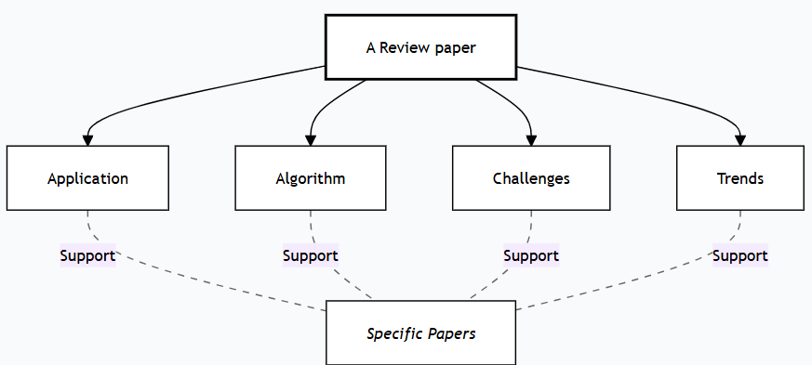
Based on:
Notes:
This presentation is based on the paper with the same name published in 2025.
I will use these as materials to discuss the importance and challenges of deep learning in MIA.

Slide 3
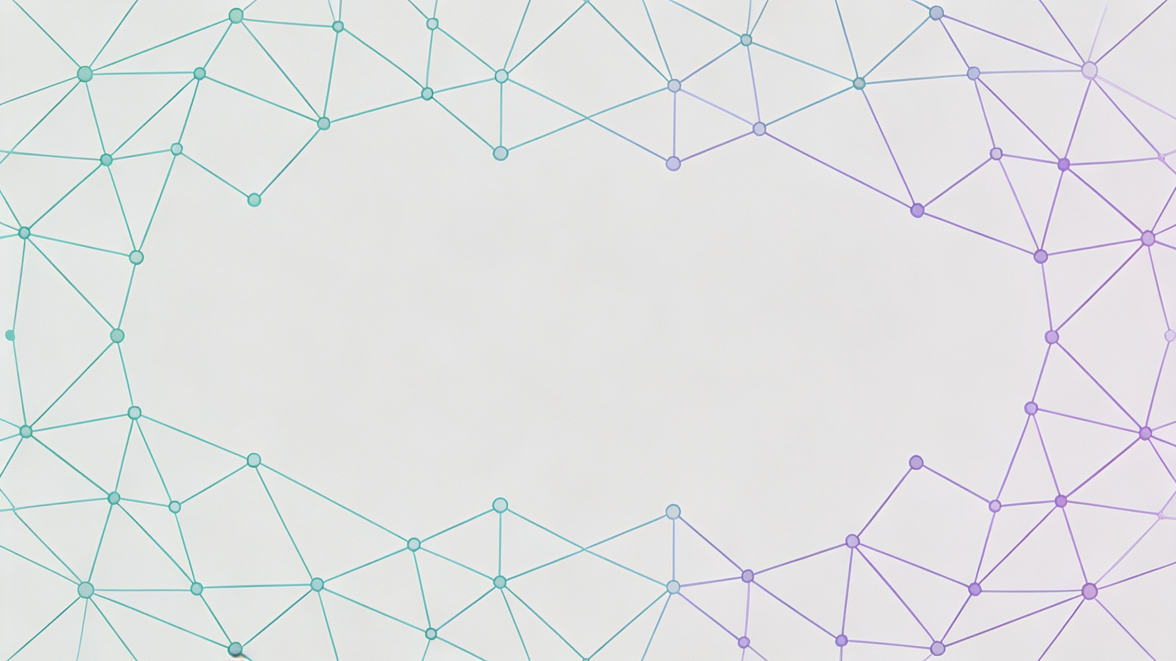








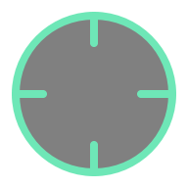







Introduction: The Convergence of DL and MIA
Main Paradigms
Classification
Registration
Convolutional Neural Networks (CNNs)
Transformer Models
Hybrid Models
Segmentation
Enhancement
Generative Adversarial Networks (GANs)
Core Advantages
Detection
Restoration
End-to-End Feature Learning
Powerful Pattern Recognition
Handling High-Dimensional Data
Scalability and Generalization
Fusion
Generation
Notes:
Deep learning has revolutionized this field. that what we have learned from our course .Therefore, the way for evaluating these models obviously need to vary depending on the different mia tasks.,

Slide 4

Comparison：Key Deep Learning Models
Methodological | Representative Models | Author’s Evaluation
Supervised Learning | ResNet, DenseNet, U-Net, TransUNet | Mature, stable, and clinically applicable; highly dependent on labeled data
Semi-Supervised Learning | FixMatch, VAT | Effective for limited annotations; reduces labeling cost while maintaining performance
Self-Supervised Learning | MoCo, SimSiam, MAE | Powerful for pre-training; improves generalization on small datasets; high computation cost
Unsupervised Learning | GANs, clustering methods | Exploratory but unstable; hard to guarantee clinical reliability
Few-Shot Learning | ProtoNet, MAML | Suitable for rare diseases; limited generalization in complex medical images
Federated Learning | FedAvg, FedProx | Enables multi-center collaboration with privacy preservation; suffers from non-IID data issues
Notes:
This table presents the author's critical summary of all representative models
Supervised learning remains the most helpful approach in the field,However, the author also mentioned many clinical limitations, such as poor scalability, high cost.
In contrast, unsupervised learning offers us a label-free future, but it is extremely hard to guarantee clinical reliability
the author mentioned Federated Learning
the data stays safely behind the hospital's firewall, and only the 'model weights' travel in different networks.
This enables preserving patient privacy, though it also requires a highly alignment.

Slide 5
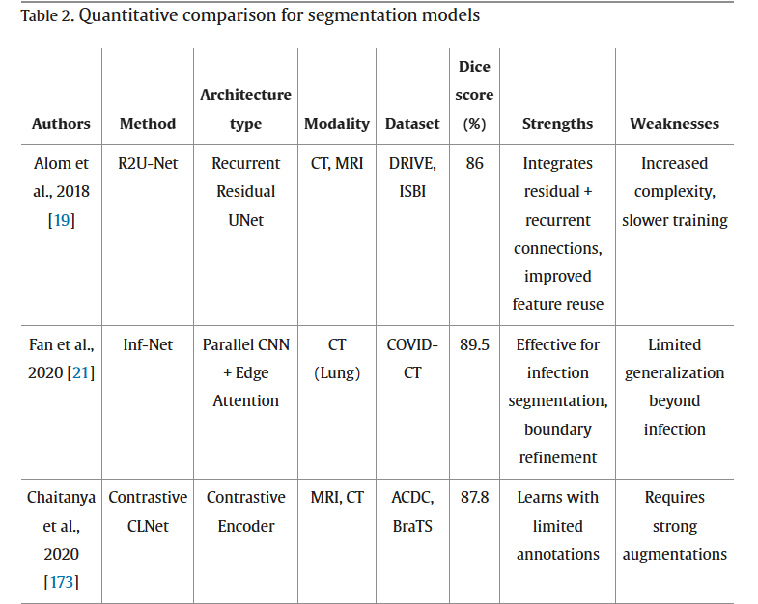
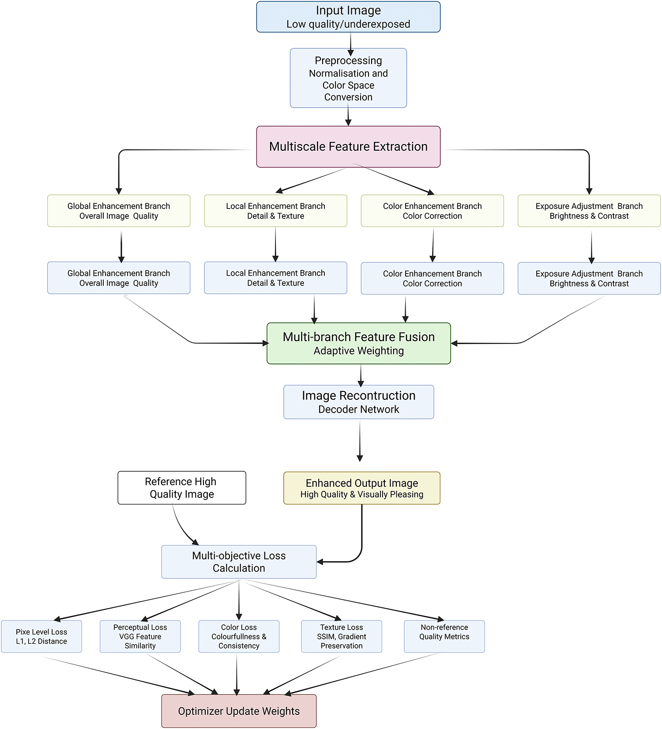
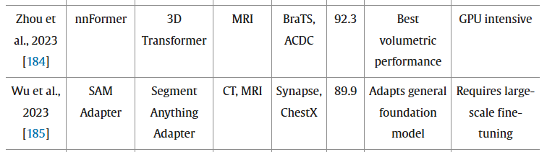
Comparison：Critical Evaluation
Segmentation
Enhancement
U-Net
Transformer-based
Notes:
Here I select two applications to show the evaluation process of this paper.One is a familiar but fundamental step in quantitative medical analysis,segmentation, and the other one is we learn less in our course but equally important, enhancement.
I directly compare the current application status of several methods.
you can see U-Net or some variants efficient, stable but sometimes miss the bigger picture while Transformer-based models improve global context . their cost are highly expensive.
For Medical image enhancement,
Traditional algorithms rely on noise solution, which often results in 'blurring' the very details we need to see.
modern approaches treat enhancement Instead of just filtering noise, these models reconstruct high-quality outputs from low-quality radiation scans

Slide 6
Model Readiness Assessment: Evaluation Metrics
Regulatory Frameworks:
Interpretability and Explainability:
Transparency, Documentation, and Reproducibility
Clinical Validation and Human-in-the-Loop Evaluation
Ethical and Societal Implications

Slide 7
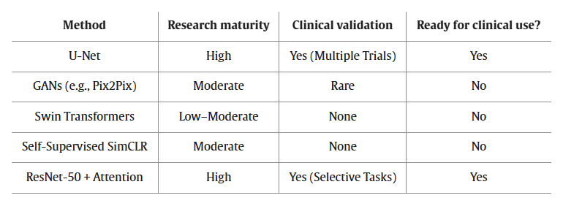
Model Readiness Assessment: Maturity Mapping
A Clinically Vetted Backbone
Transformative but Unstable
Promising but Immature
Representation Bottlenecks
Practical in Clinical Subtasks
Notes:
They notice that the line between experimental models and those ready for clinical development is often blurred in nowadays research. So they propose a maturity mapping framework
With this mapping table, Research models with low maturity (e.g., transformers, GANs) should be presented with disclaimers, To prevent the misuse of conceptual models in clinical practice, which could result in dangerous or harmful situations.

Slide 8
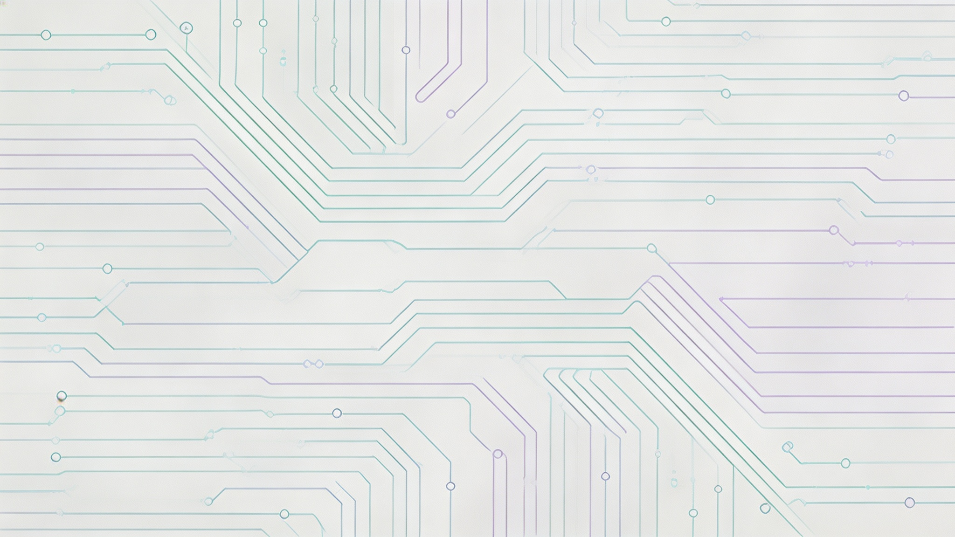
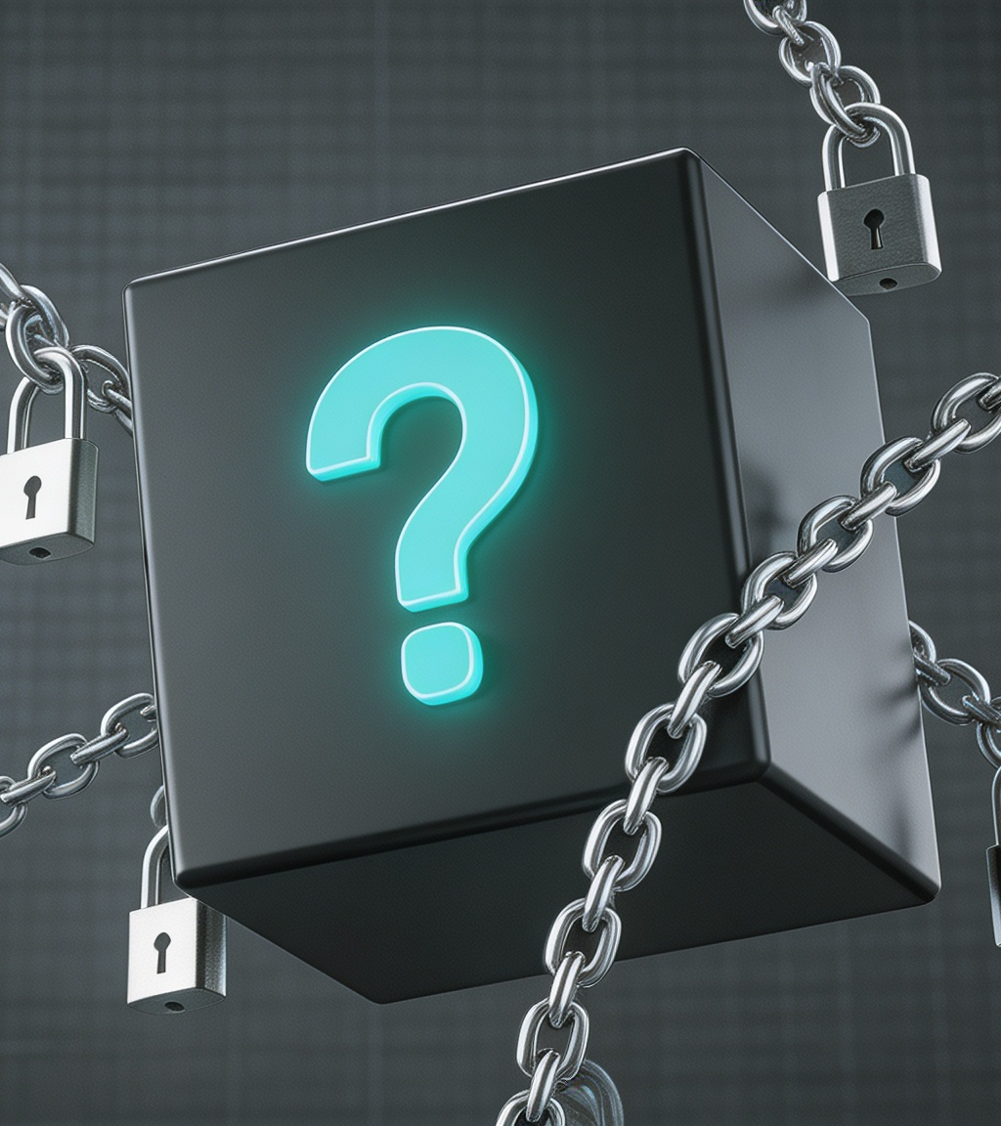




Challenges in Deep Learning for Medical Imaging
Data Scarcity & Quality
The " Black Box" Problem
Datasets are small due to privacy and rarity. Manual labeling is costly and requires specialized medical expertise.
Clinicians need explainability to trust AI. Techniques like Grad-CAM help visualize the model's diagnostic logic.
Generalization & Robustness
Computational & Regulation
Models fail on data from different scanners (domain shift). They are also vulnerable to adversarial attacks.
Complex models demand expensive GPU resources. Integrating AI into clinics involves lengthy regulatory approval.
Notes:
black box
Even if a model has 99% accuracy, a doctor cannot simply take its word to real life. In a high-risk environment like an ICU or a surgical suite, 'the AI said so' is not a valid convinced clinical method.
To bridge this gap, the auhtor mentioned some methods , but I believe since doctors and patients are all humanbeings ,at least so far,
the black box problem is still waiting to be discussed forever.

Slide 9
Thanks for Listening！

